Slide 1

Breaking barriers: Arduino core API advancements in Zephyr, Linux and IoT Systems
Date: 15th November, 2023
Dhruva Gole

Slide 2







About us: TI Processors and Open source
Decades of contribution and collaboration
Ingrained culture to give back to the community
Upstream FIRST!
Focus on long term, sustainable and quality products
Upstream and opensource ecosystem in device architecture
Upstream FIRST mentality!

Slide 3

About me
Software Engineer at Texas Instruments, Bangalore.
Power Management on Sitara SOC’s
U-Boot and Linux Device Driver Development
Maintainer of Arduino Core API for Zephyr

Slide 4

Overview
Background
About Arduino core API
Arduino API + Zephyr
Project Structure
Challenges
Native posix
Testing your Arduino Code
Future Plans

Slide 5
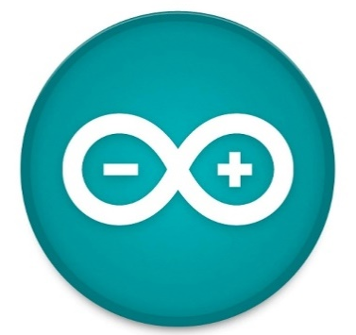
About Arduino
What is Arduino?
  Arduino is an open-source electronics platform
  easy-to-use for beginners, yet flexible enough for advanced users
ArduinoCore-API
  coded to the C++11 standard
  API for the Arduino programming language
  This repository hosts the hardware independent layer of Arduino core.

Slide 6
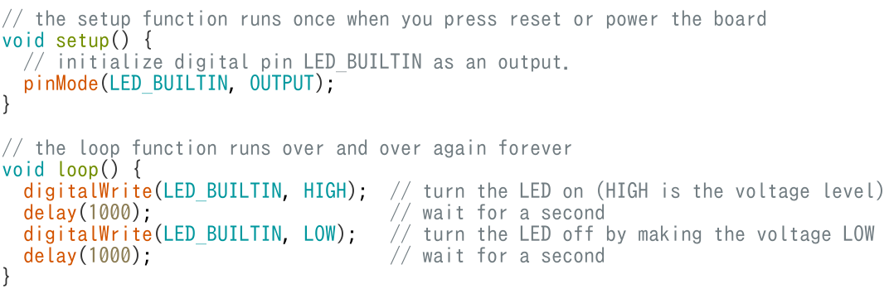
Arduino code generic structure
src: https://docs.arduino.cc/built-in-examples/basics/Blink

Slide 7
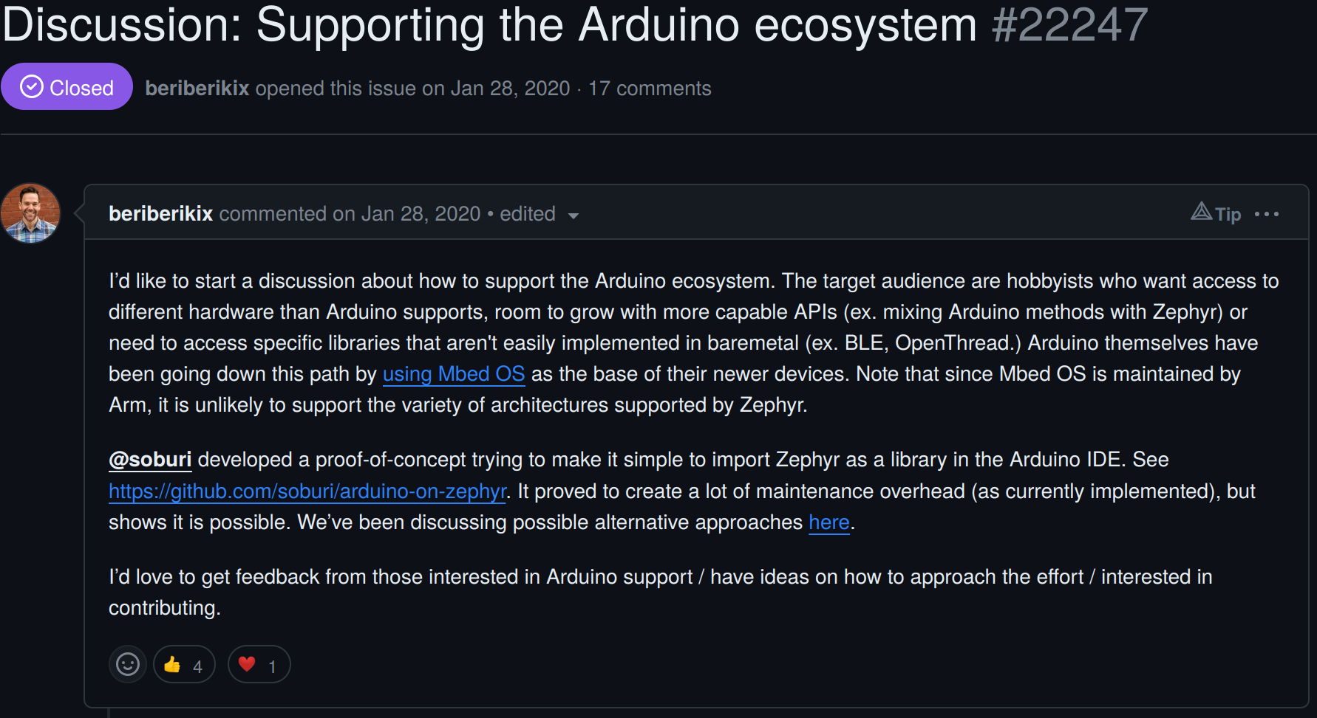
Background
Notes:
* I was trying to develop on some platforms in Arduino but ended up having RTOS reqs.
* I could not find any good options, and wanted to use Zephyr RTOS. It wasn’t supported on any native Arduino platforms.
* Thinks if there’s some way/ API to just run arduino code using zephyr underneath?
* Jonathan’s idea to Support the Arduino ecosystem
* Target audience are hobbyists who want access to different hardware than Arduino supports
* Thus commences our GSoC project.

Slide 8
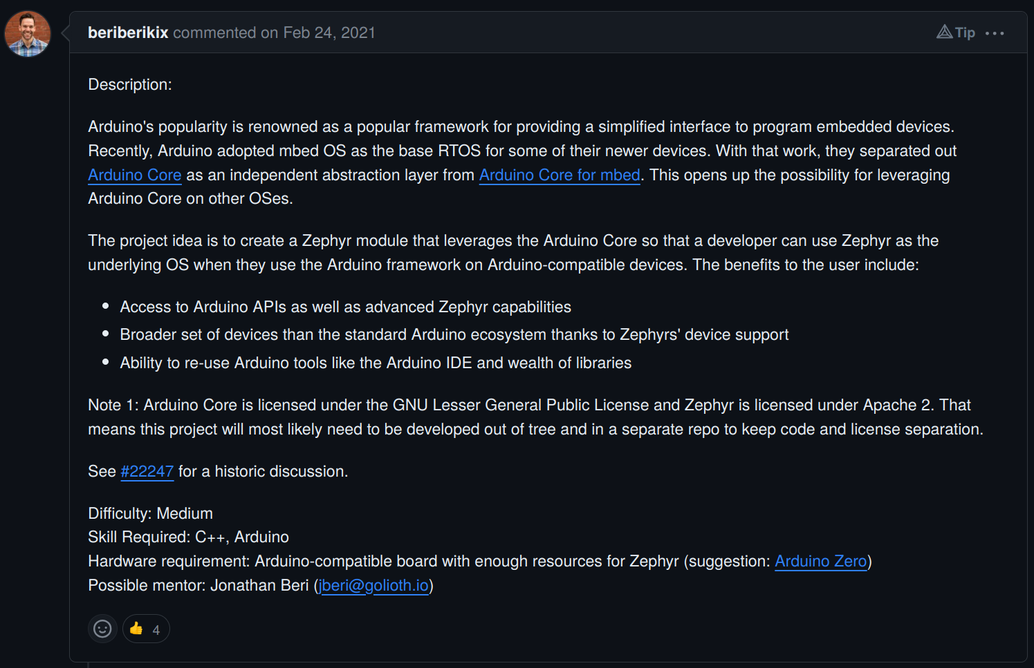

Slide 9
Arduino + Zephyr = Easier Development
Many developers come from an Arduino background
Past projects and prototyping are mostly done in Arduino.
Requirement to move to an RTOS based system
Zephyr seems a lucrative non-vendor specific open source option.
Learning new APIs of Zephyr and migrating the entire prototype code is a massive investment.
Now, possible to use Zephyr RTOS features with Arduino-style syntax.
Leverage the many boards already supported within zephyr, without needing to learn a whole new set of APIs. Eg. TI-CC3220SF
Enhanced debugging abilities

Slide 10
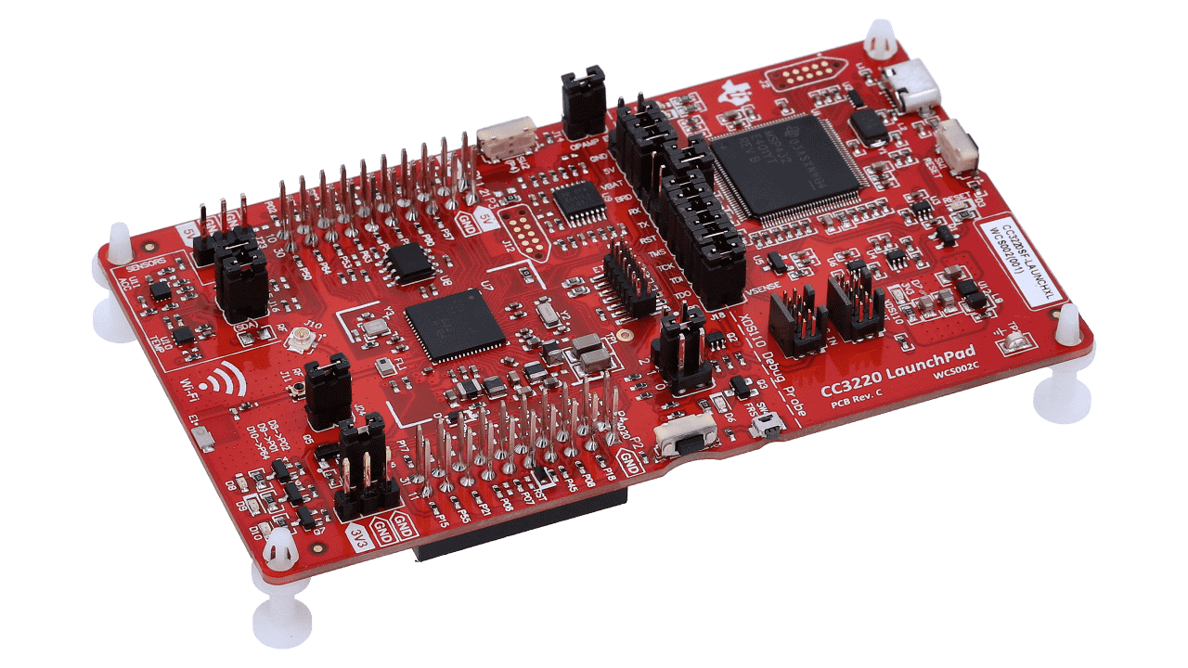
TI CC3220SF
No inherent support in the Arduino IDE
Has TI SDK: SIMPLELINK-CC32XX-SDK
No support as such to readily run existing Arduino projects/ tutorials.
Now Possible!
The Arduino core API has support for CC3220SF.

Slide 11
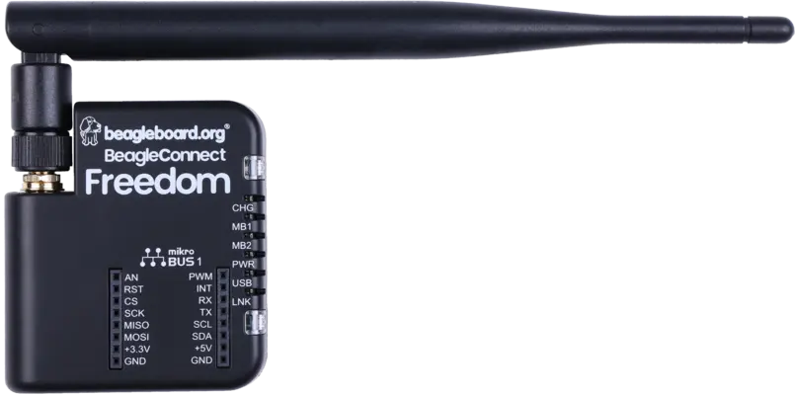
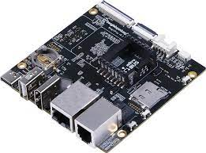
Linux SBC
Want to run Arduino code on linux platforms like beagleplay?
The beagleplay also comes with it’s own MCU cortex M4 core.
Opportunity to develop, test and deploy Arduino Code on the edge
AM62x: Develop and build your Arduino based app.
native_posix/simulator: Run basic checks and test/debug binary.
Run/Deploy app onto the M4 core!
Handheld BCF: Potentially can also run
Arduino code.

Slide 12
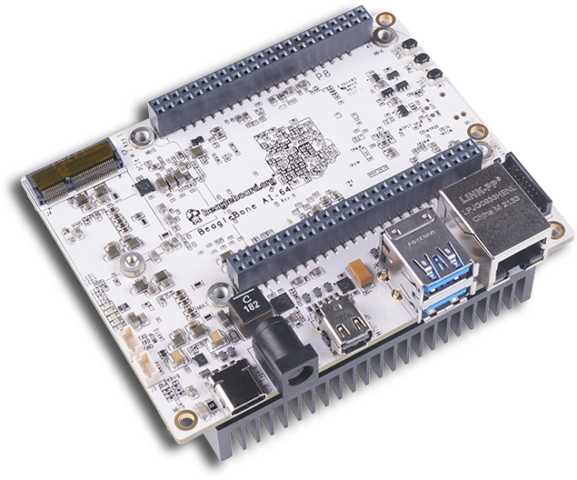
BeagleBone AI64
Texas Instruments TDA4VM SOC
Dual Arm Cortex-A72 microprocessor
Accompanied by Cortex R5 cores
Tonnes of I/O’s!
Excellent platform for rapid yet feature rich
application development.
GSoC project: Zephyr support for the
R5 core

Slide 13
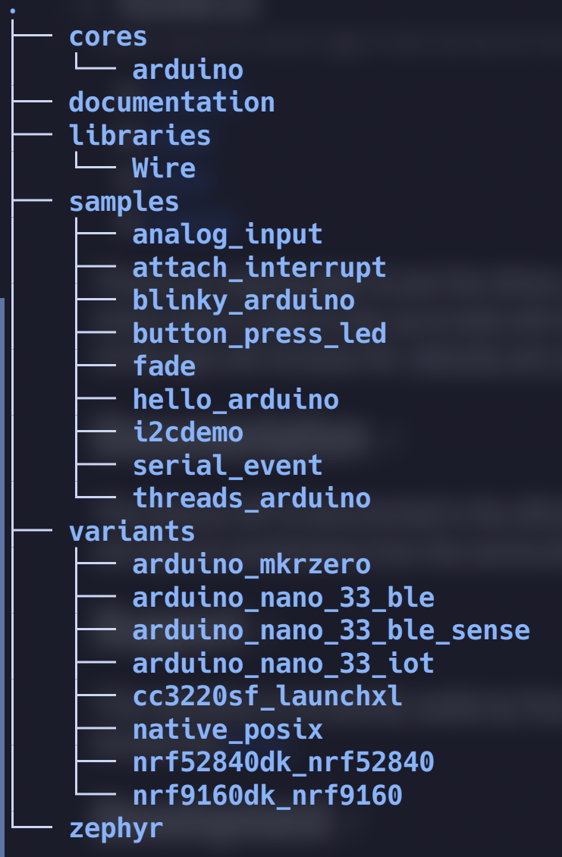
Module structure
core
  Contains the actual implementation and API symlink
variants
  board overlays and header files
samples
documentation

Slide 14
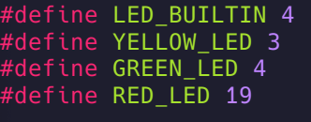
Adding new variants
Variants are isolated from the core API for standadization.
2 Easy steps:
  Add an overlay file that matches the name of the board. (board.overlay)
  (optional) Add board specific defines to new header file called variants.h
  One reason for board specific headers is mapping custom pins/LEDs.
CC3220SF LaunchXL

Slide 15
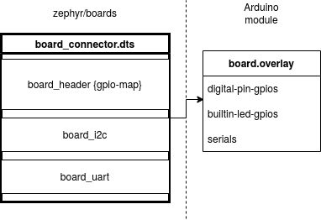
DT Overlay for Arduino

Slide 16
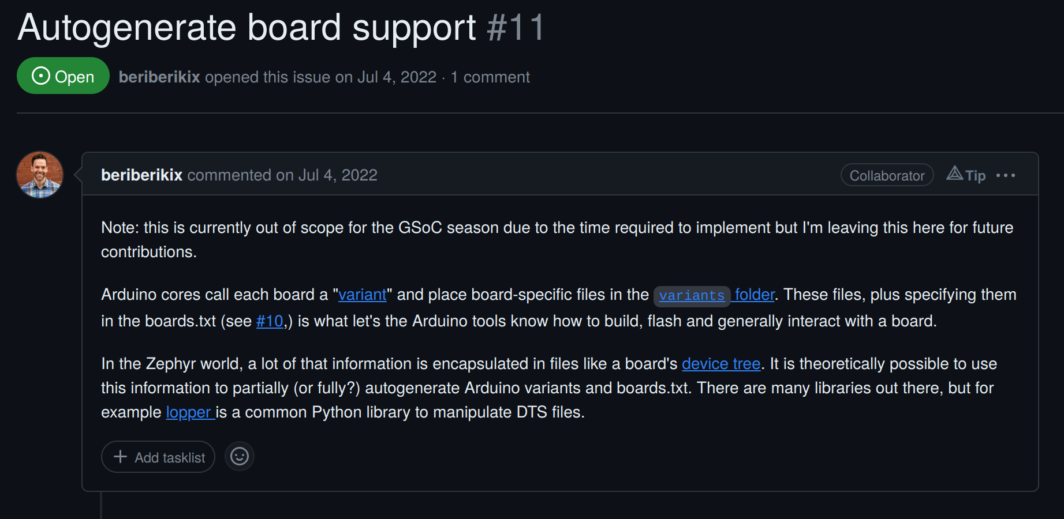

Slide 17
GPL vs Apache
Arduino is LGPL V2 licensed
Zephyrproject is Apache licensed.
Officially - both of these are incompatible.
Hence, Arduino continues to reside as an external repo / module.
Any ways to allow mainstream to include Arduino?

Slide 18
Integrate arduino api PR#64051
Shifting all overlays to upstream Zephyr.
Adding a submanifest for the rest of the module.
Add arduino-core shield to handle board specific overlays.
Allows us to isolate the GPL code from upstream Zephyr,
Keeps the GPL code part of a seperately maintained repo like Arduino Core for Zephyr thus ensuring Apache and GPL don’t reside in a single place.

Slide 19
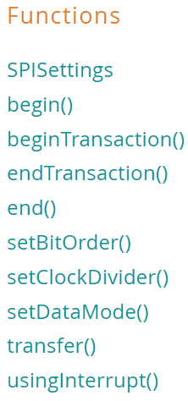
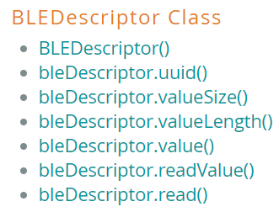
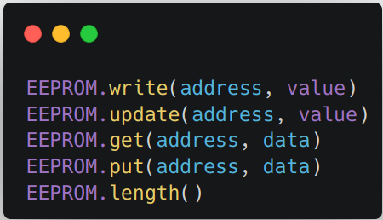
Extending Library Support
EEPROM
SPI
ArduinoBLE

Slide 20
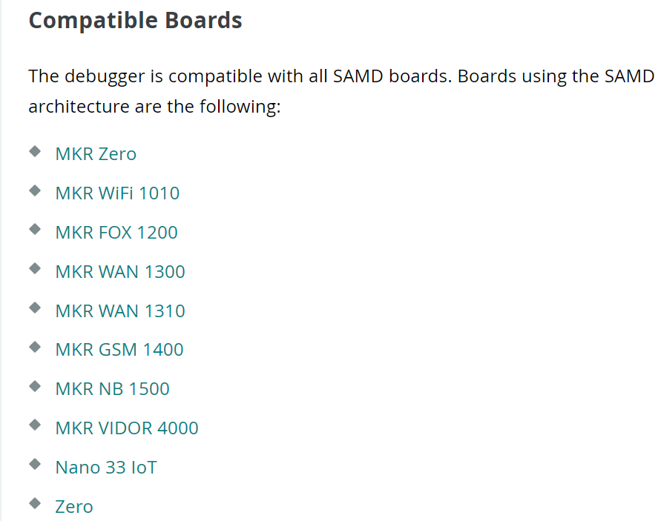
Enhanced debugging options
Arduino IDE has limited debugging support.
Zephyr + Arduino = no limitations
Open OCD
Vendor debuggers
VS Code

Slide 21
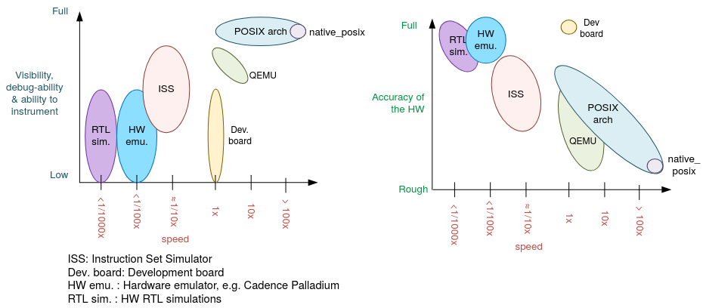
Native POSIX
Zephyr application can be compiled together with the Zephyr kernel, creating a normal Linux executable.
Board is based on POSIX architecture, shares its basic architecture regarding threading and CPU/HW scheduling
https://docs.zephyrproject.org/latest/boards/posix/doc/arch_soc.html

Slide 22
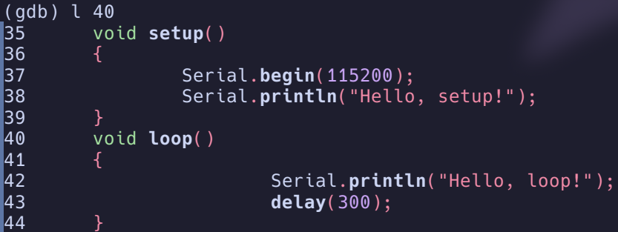
Debugging with Native POSIX
RTOS’es can be difficult to debug, especially on embedded platforms.
  Multi-tasking issues
  RTOS-level tracing
  Preemption
With native posix: debug and instrument as any other native program!

Slide 23
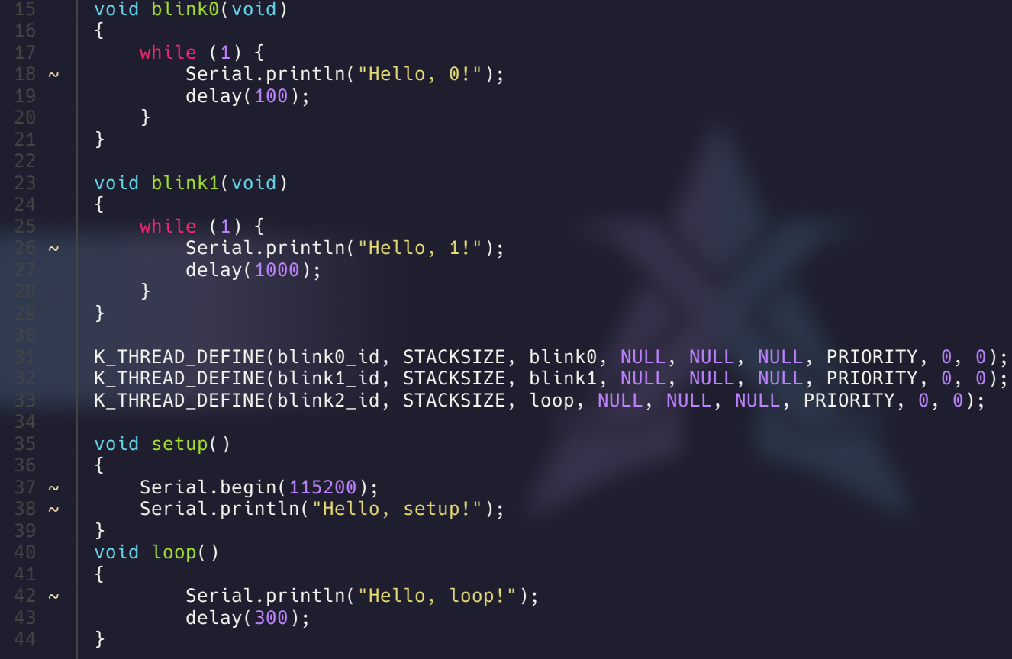

Slide 24
Test/debug using native_posix on host
Provides a simple and quick way of prototyping Arduino code.
Possible to leverage Zephyr I2C Emulation for I2C testing.
Example of basic UART + Threads test

Slide 25
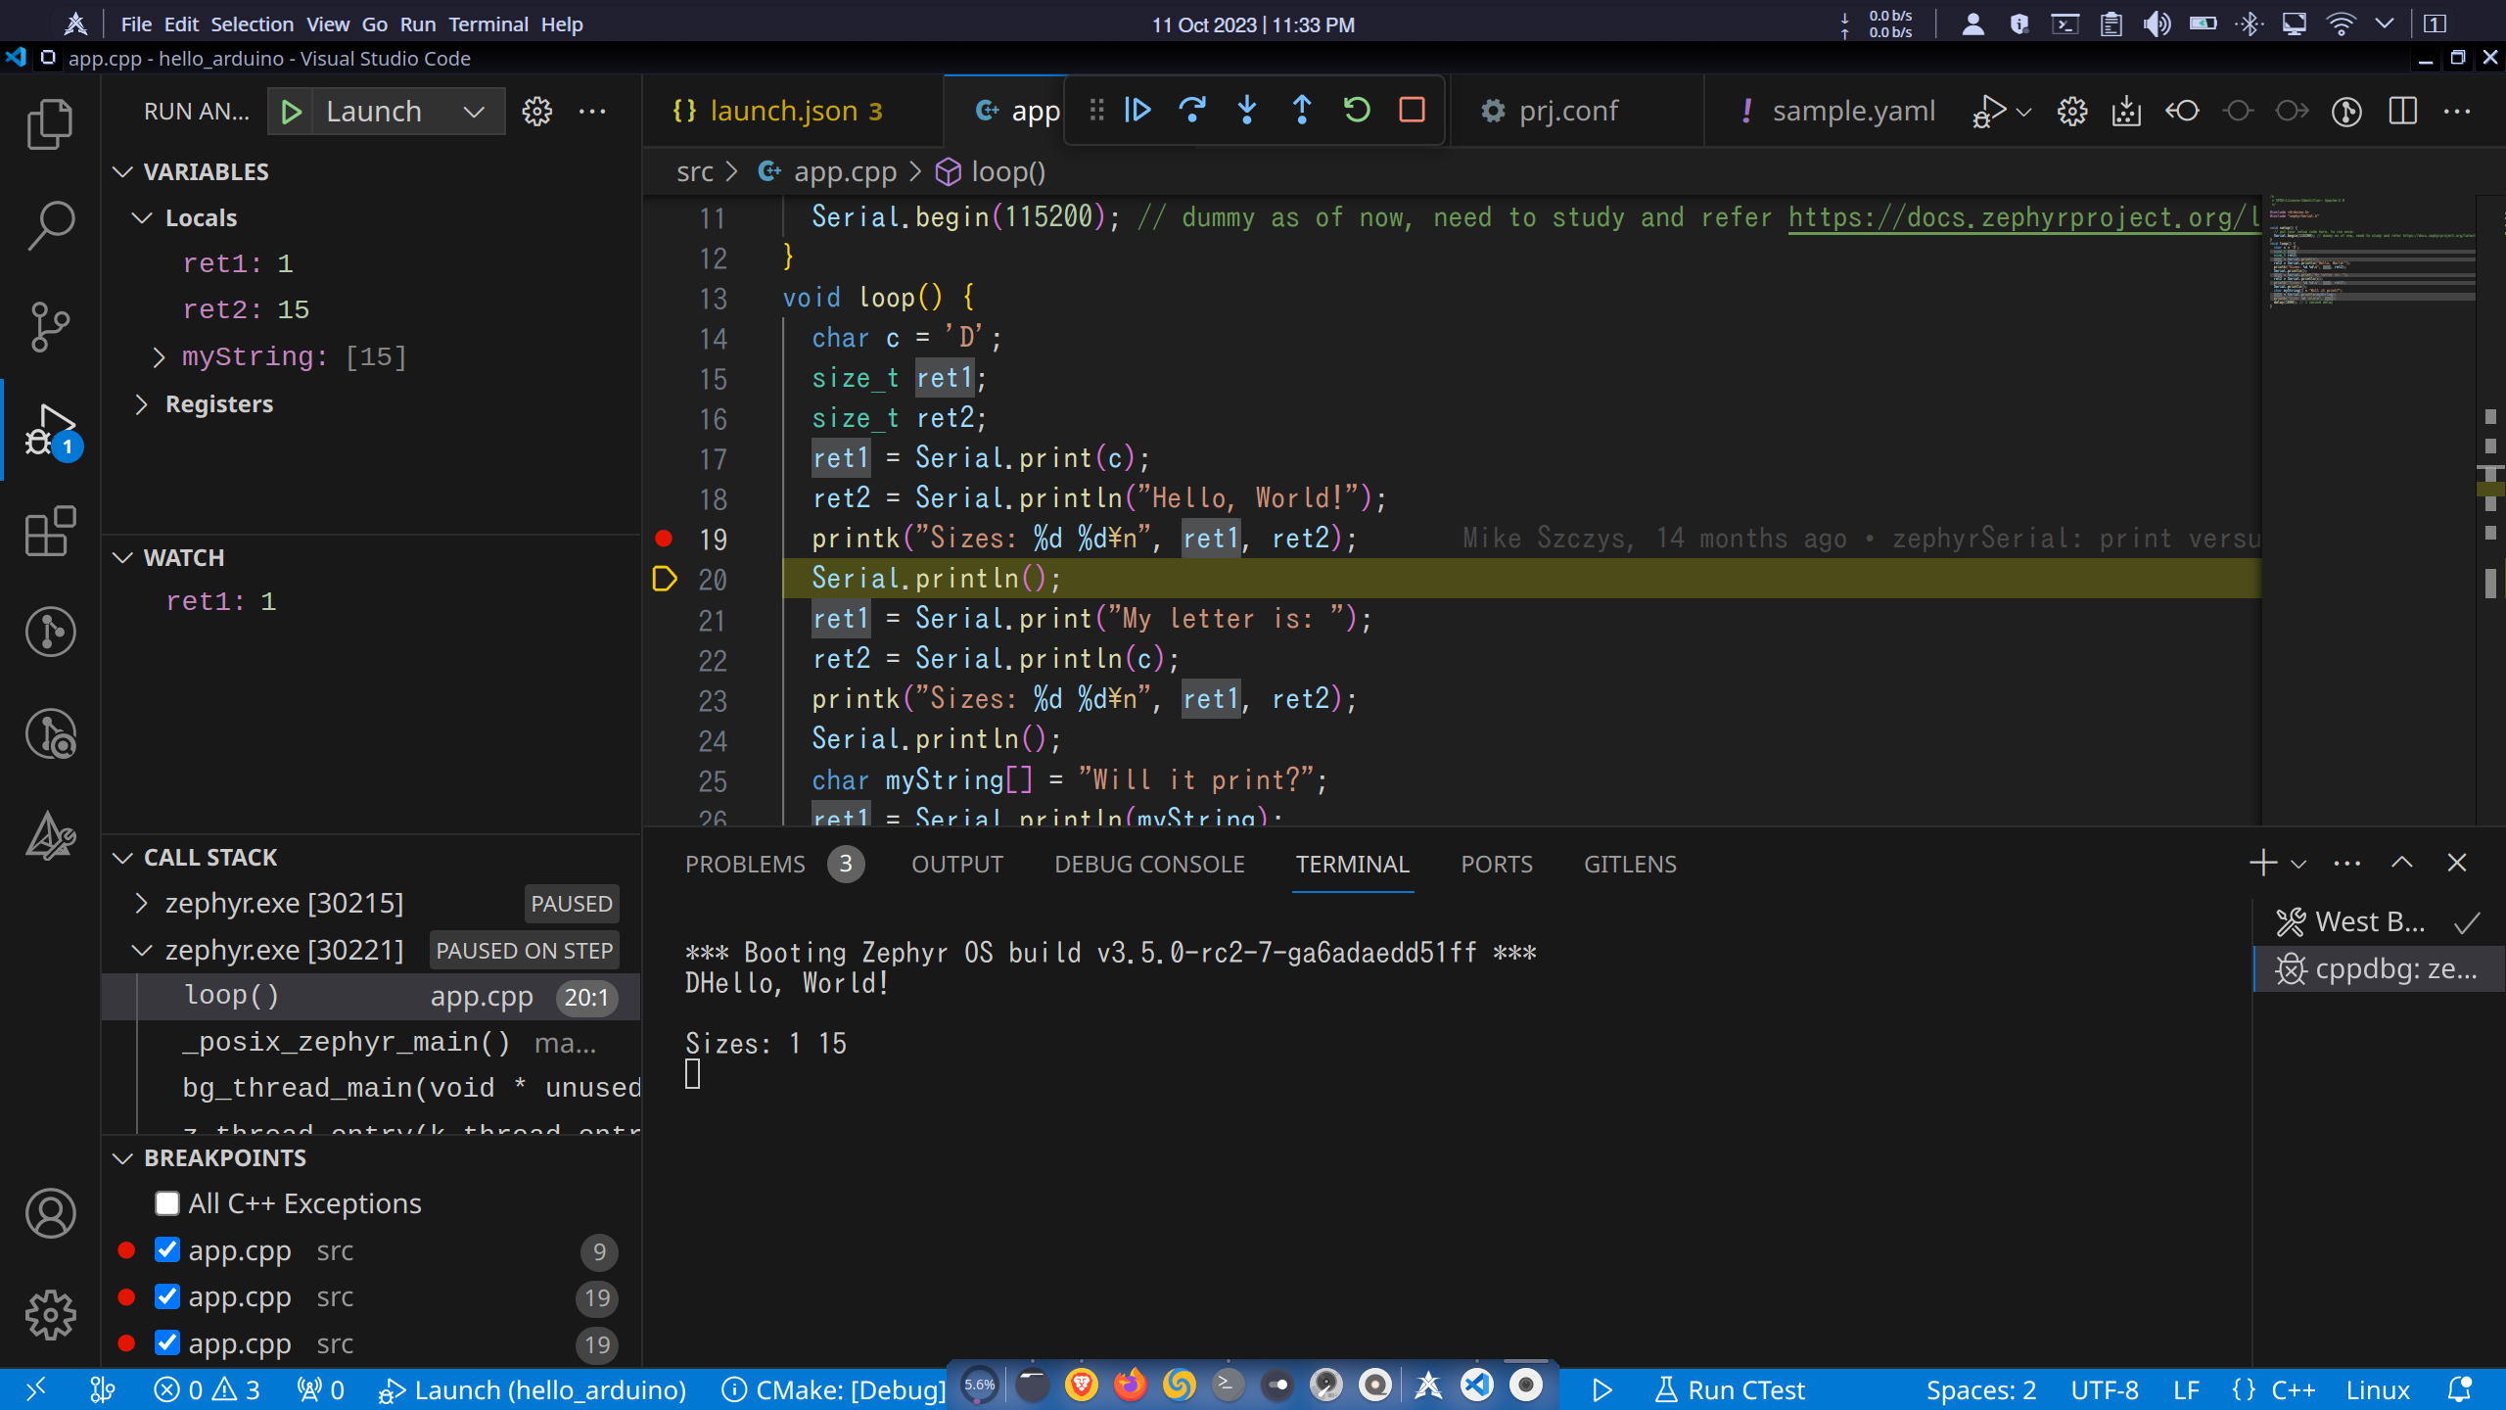

Slide 26
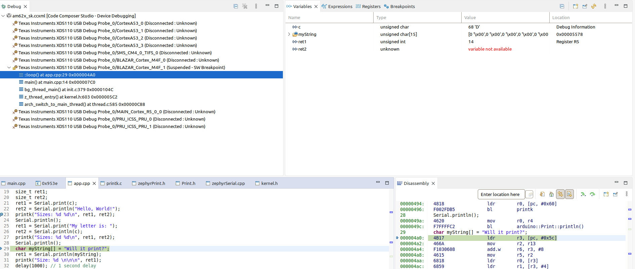
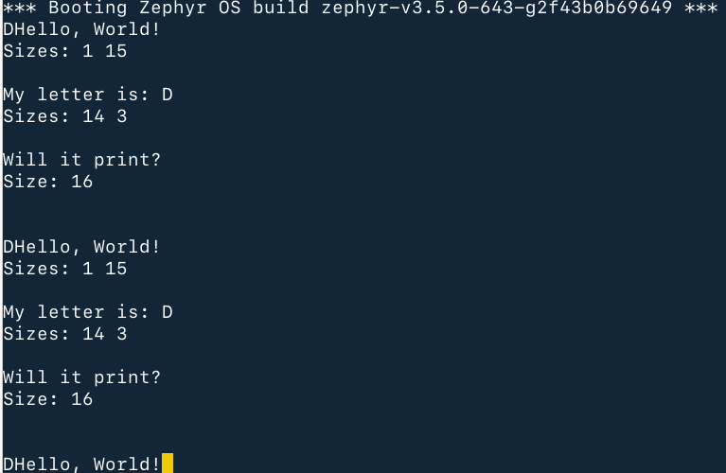
Debugging on AM62x M4 core

Slide 27
Key Takeaways and Future Scope
Upstreaming Arduino Core API to Zephyr.
Further expantion of the Arduino API’s like SPI, EEPROM, BLE, etc.
Adding support for native_sim to allow host level debug and testing.
Making it easy to add new variants using something like lopper.
Making Arduino code seemlessly work on a POSIX system
For eg. running Arduino code on a Beagleplay/BeagleBone AI-64 not just with simulated peripherals but actually use the POSIX calls to make real impact on it’s hardware like GPIO, I2C, SPI, etc.

Slide 28
References
https://github.com/zephyrproject-rtos/gsoc-2022-arduino-core
https://blog.golioth.io/zephyr-arduino-a-google-summer-of-code-story/
https://dhruvag2000.github.io/Blog-GSoC22/
https://github.com/zephyrproject-rtos/zephyr/issues/22247
Notes:
Inclusive terminology : review entire presentation.

Slide 29
Credits and Acknowledgement
Texas Instruments Inc.
The Linux Foundation.
Golioth.io
Vaishnav, Christopher, and TOKITA Hiroshi

Slide 30
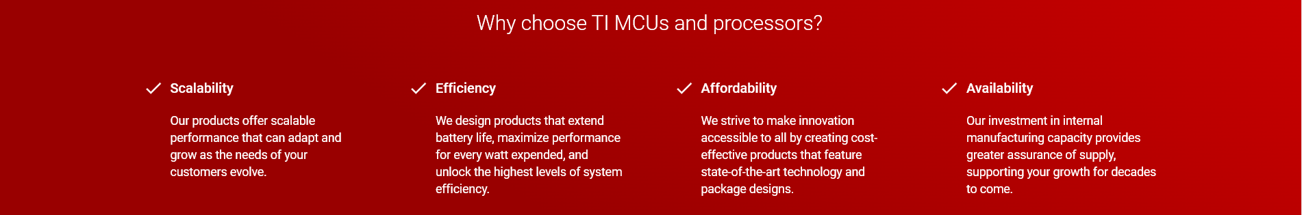
Q&A
Learn more about TI products
Contact Information:
  Dhruva Gole <d-gole@ti.com>
Also on IRC @ libera.chat #linux-ti
https://www.ti.com/linux
http://opensource.ti.com/
https://www.ti.com/processors
https://www.ti.com/edgeai

